Slide 1
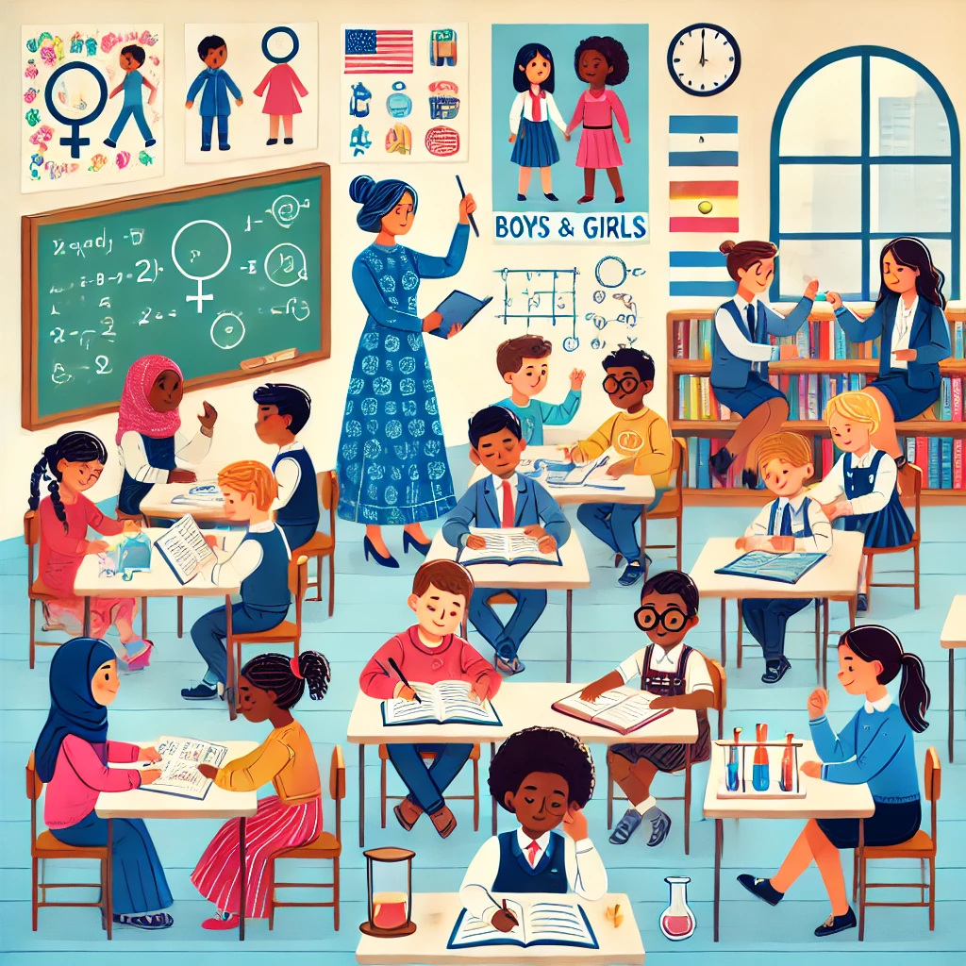
Gender Sensitive Pedagogy and Teaching Dr Melis Cin 27 September 2024

Slide 2
What is Gender Sensitive Pedagogy and Teaching?
Think back to your school days:
Did you ever feel limited by your gender in terms of what you could say or do in the classroom? Were there activities you wanted to participate in but felt discouraged or unable to because of gender expectations?
How can we ensure our students don’t feel the same way? That’s why we need gender sensitive pedagogy and teaching?

Slide 3
What is Gender Sensitive Pedagogy and Teaching?
Teaching and learning approaches that address the unique needs of both boys and girls.
Not just focused on girls but aims to close the historical and cultural gaps they face.
inclusive learning environment that supports both boys and girls in overcoming gender-related barriers.
Example: Boys may need additional support in developing soft skills such as teamwork, communication, and emotional regulation, as they are often encouraged to be more independent and less expressive. On the other hand, girls might require more encouragement to participate actively in class discussions or pursue subjects like information technology, engineering, and mathematics (STEM), which are sometimes perceived as male-dominated fields.

Slide 4
1. Gender Biased Language
Verbal Communication:
Teachers might discourage girls from taking science by telling them that such subjects are for boys or are too difficult for girls.
If a boy student cries or expresses vulnerable emotions, a teacher might tell him to stop acting like a girl
Nonverbal communication:
rolling one’s eyes
raising
eyebrows or smirking at a response or question that a girl might share
winking, touching, brushing, grabbing and
other physical moves may be covertly or overtly sexual

Slide 5
Is Doing like a girl bad thing?
Promote Positive Reinforcement: Show students how "like a girl" can be empowering by celebrating accomplishments of women and girls in various fields (e.g., science, athletics, leadership).
Professor Nguyễn Thị Kim Thanh
Accomplishments: She is an award-winning physicist and nanotechnology expert, recognized for her pioneering research in magnetic nanoparticles for biomedical applications, including cancer treatment. She has received numerous international accolades, including the Rosalind Franklin Medal and Prize in Physical Sciences.
Why: Professor Thanh’s groundbreaking work in science and technology showcases intelligence, innovation, and leadership in a traditionally male-dominated field. She serves as a powerful example of how women can excel in STEM, helping to challenge stereotypes about gender and scientific ability.
Nguyễn Thị Phương Thảo
Accomplishments: The CEO of VietJet Air and Vietnam's first self-made female billionaire.
Why: Her entrepreneurial success can represent intelligence, innovation, and breaking gender norms in business.

Slide 6
Mankind • Man’s achievements • All men are created equal • The best man for the job • Chairman • Businessman • Congressman • Policeman • Scienceman
• Humanity, human beings, people • Human achievements • All people are created equal • The best person for the job • Chair, head, chairperson • Business executive, manager, businessperson • Congressional representative • Police officer • Scientist

Slide 7
2. Interaction in the Learning Environment
Equitable Distribution of Attention
Issue: Teachers may unconsciously call on male students more frequently, wait longer for their responses, or give them more attention.
Training in Active Listening
Issue: Teachers may unintentionally interrupt female students before they finish responding, which not only discourages their participation but can also signal to other students that their input is less valued.
Promoting Equal Participation in Group Work
Issue: In group work, male students may tend to dominate discussions or leadership roles, while female students might take on supporting or passive roles.
Addressing Gender Stereotypes in Class Discussions
Issue: Teachers may unconsciously attribute comments to male students more often, or give them more credit in discussions, reinforcing the stereotype that males are more intellectual or authoritative.
Creating Safe and Inclusive Spaces for Expression
Issue: Female students may feel less confident or safe in expressing themselves in male-dominated subjects or discussions.
Gender-responsive pedagogy is essential for addressing and correcting the gender imbalances in classroom interactions, particularly the unconscious biases and gender dynamics that influence how teachers engage with male and female students.

Slide 8
Case Study 1: Equitable Distribution of Attention
Issue:
In a high school science class in Ho Chi Minh City, the teacher often finds male students volunteering to answer questions more frequently than female students. During class discussions, boys are called upon more often, given more time to respond, and their answers receive more praise. As a result, the girls become quieter and participate less, reinforcing the stereotype that boys are better at science.
How would Gender-Responsive Pedagogy respond?:
Participation Log: The teacher begins to keep a simple log during each class, noting how many times male and female students are called upon and how much time is given for them to answer. This helps the teacher become more aware of the imbalance.
Group Responses: For certain questions, the teacher divides the class into small groups, each containing an equal mix of boys and girls. This encourages collaboration and ensures that both genders contribute equally to the group’s response. The teacher also monitors group dynamics to make sure no single gender dominates the discussion.
Encouragement and Positive Reinforcement: The teacher consciously makes an effort to provide equal encouragement and feedback to both boys and girls. When a female student answers a question, the teacher praises her for her effort and gives constructive feedback, helping to build her confidence in the subject.
Structured Waiting Time: The teacher practices structured waiting time after asking a question. Instead of moving quickly to another student if a girl hesitates, the teacher gives her the same amount of time to think and respond as she would a male student, signaling that both genders are equally capable of answering challenging questions.

Slide 9
Case Study 2: Creating Safe Spaces
In a high school STEM class in Hanoi, female students often remain quiet during discussions, especially when the topic involves complex math or physics problems. Male students tend to dominate the conversations, and girls may hesitate to express their thoughts due to fear of being wrong or judged, as STEM is often perceived as a male-dominated field in Vietnam.
Solution Using Gender-Responsive Pedagogy:
Encouraging Female Participation: The teacher begins by openly encouraging female students to share their opinions in class discussions, particularly when the subject involves traditionally male-dominated areas like math and physics. During problem-solving sessions, the teacher specifically asks for female students’ perspectives, ensuring that their voices are heard.
Validating Contributions: When a female student speaks up or presents an answer, the teacher provides positive, constructive feedback, emphasizing the value of her contribution. Even if her answer isn’t entirely correct, the teacher highlights what she did well, fostering a supportive atmosphere where making mistakes is seen as part of the learning process. For example, after a female student shares a solution, the teacher might say, “That’s a great start, Mai. You’ve identified the correct approach. Let’s work through the next steps together.”
Creating Small Discussion Groups: To further encourage participation, the teacher organizes small-group discussions with a balance of boys and girls. In these smaller settings, female students may feel less pressure and more comfortable expressing their thoughts. The teacher rotates leadership roles within each group, ensuring that girls take turns leading the discussions, which helps to build their confidence in STEM subjects.
Role Models and Success Stories: The teacher also introduces examples of successful Vietnamese women in STEM fields, such as Professor Nguyễn Thị Kim Thanh, to inspire female students. By showcasing women who have excelled in science and technology, the teacher challenges the stereotype that STEM is only for men and shows girls that they can succeed in these fields.
Designated “Safe Space” for Questions: The teacher establishes a designated time at the end of each lesson where students can anonymously submit questions or express concerns, especially those who may feel too shy to speak up during class. This anonymous space helps girls feel safer asking questions about topics they might be unsure of without the fear of embarrassment.
Supportive Peer Environment: The teacher promotes a classroom culture where all students are encouraged to support and listen to each other’s contributions. When a female student speaks up, the teacher actively engages the whole class by asking, “Who else can build on this idea?” or “What can we learn from this approach?” This approach encourages boys to listen and respect female students' input, helping to create a more balanced and inclusive classroom dynamic.

Slide 10
3. Lesson Planning
A lesson plan serves as a teacher’s guide for creating an effective teaching and learning experience and for addressing the diverse learning needs of students, which may arise from varying social backgrounds and learning styles.
A gender-responsive lesson plan goes further by incorporating the unique needs and considerations of both girls and boys throughout the entire teaching process. This includes aspects such as selecting teaching materials, choosing methodologies, organising learning activities, and arranging the classroom environment in a way that promotes gender inclusivity.

Slide 11
Instructional Materials
Common examples of these biases include the portrayal of traditional gender roles, such as the father reading the newspaper while the mother serves dinner, or a male doctor and a female nurse. Similarly, boys are often shown playing with balls, while girls are depicted combing dolls' hair.
For example, if a history textbook highlights only male heroes, create a complementary list of female heroines. If a science textbook only features male inventors, include discussions about female scientists who have made significant contributions.

Slide 12
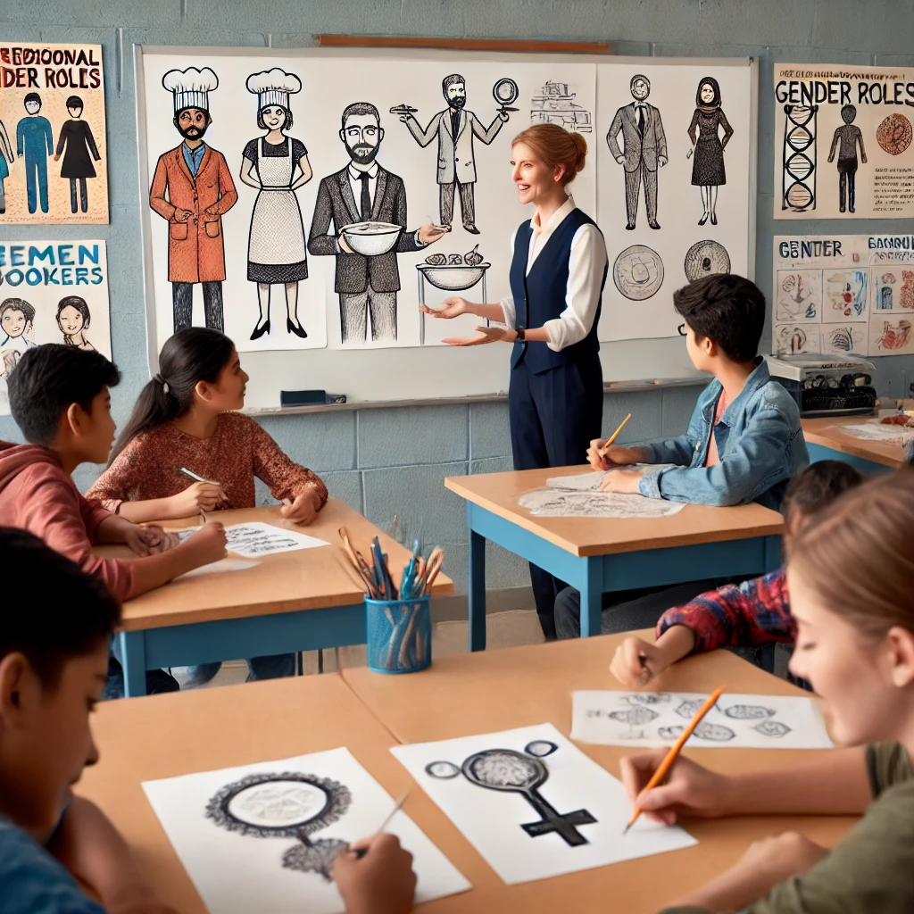
. Traditional Gender Roles in Textbooks and Visuals
Issue: In textbooks, illustrations often depict fathers as the breadwinners, sitting and reading the newspaper or working, while mothers are portrayed as caretakers, cooking or cleaning. Boys are often shown playing sports or engaging in physical activities, while girls are depicted helping in the kitchen or playing with dolls.
What would Gender-Responsive Pedagogy suggest?:
When encountering such representations, teachers can introduce discussions that challenge these stereotypes. For instance, teachers can ask students to describe alternative roles (e.g., fathers cooking and mothers reading) and encourage them to imagine and draw new images that reflect more gender-balanced family roles.
Use additional resources or real-life examples of Vietnamese families where both parents share responsibilities equally, and discuss how these roles can change and evolve.

Slide 13
Gender Bias in Career Depictions
Issue: Textbooks often portray men in leadership or STEM roles, such as doctors, engineers, or scientists, while women are shown as nurses, teachers, or caregivers. This creates an implicit message that some careers are gender-specific.
What would Gender-Responsive Pedagogy suggest:
Teachers can bring in examples of successful Vietnamese women in STEM, such as Professor Nguyễn Thị Kim Thanh, a leading nanotechnology scientist, or Đặng Thị Ngọc Thịnh, Vietnam's first female vice/president, to show that women can excel in traditionally male-dominated fields.
Teachers can also introduce career exploration activities where students research professionals in various fields, ensuring an equal representation of both genders. They can encourage both boys and girls to present on careers that break traditional gender norms.

Slide 14
Teaching Methodologies
A gender-responsive approach uses methodologies that are learner-centered, build both skills and knowledge, and ensure equal participation for both girls and boys. They can be applied in classrooms to promote equity and inclusivity. These methodologies include:
Group discussions: Encourage equal participation and collaboration between students of all genders.
Guest speakers: Provide diverse role models from different fields, ensuring that both male and female voices are represented.
Field trips: Offer real-world learning opportunities that reflect gender balance in various professions.
Role play: Allow students to explore different perspectives and break gender norms in a safe environment, such as acting out scenarios where gender norms are reversed,
Debates and case studies: Engage students in critical thinking about gender equality and social issues.
Explorations and community projects: Empower students to apply their learning to local, real-world contexts while promoting inclusive participation.

Slide 15
Example 1: Oral Herstory Project
Objective: Develop research skills, explore oral history techniques, and create public exhibits to celebrate the contributions of women in your community. Shift the cultural narrative by recognizing women as central to community life and well-being.
Rationale: Oral history captures firsthand experiences through interviews and conversations, highlighting perspectives often left out of official records. Historically, women's contributions have been overlooked, and their stories rarely told. By elevating women’s voices, we challenge norms that perpetuate gender-based violence and discrimination, and refocus history on women’s vital roles in areas like agriculture, medicine, education, spirituality, and decision-making. Centering women's narratives transforms societal views, moving from tales of violence and conquest to stories that celebrate relationships, community, and everyday life.
Activity: Asking students to interview a woman from their community.

Slide 16
Example 2: Project-Based Learning with Real-World Gender Contexts
Practice: Design project-based learning activities that incorporate gender perspectives and address real-world gender issues. This methodology can encourage students to explore how gender impacts their communities and the world.
Example: In a geography class, students can be tasked with researching how climate change affects men and women differently in rural areas. They explore case studies from Vietnam and other countries and create presentations that highlight how gender influences roles in agriculture, decision-making, and environmental management.

Slide 17
Research and Data Collection
Task: Ask students to research how climate change affects men and women differently, particularly in agricultural communities. For instance, men and women may have different responsibilities in farming (e.g., men may handle more physically intensive labor, while women manage household farming duties and resource collection).
Action: Encourage students to explore case studies both from rural regions of Vietnam and internationally. They can use a variety of sources such as reports, government data, or interviews with local farmers, NGOs, or environmental groups.
Analysis of Gender Roles:
Discussion: Have students discuss how gender roles impact decision-making, labor distribution, and resource access in their research. For example, they might find that women are less likely to have a voice in community decisions about environmental management, even though they are often responsible for water collection or household food production.
Reflection: Guide students to reflect on how traditional gender roles might limit participation or lead to unequal impacts from climate-related events like floods or droughts.
Student Presentations:
Presentation: After researching and analyzing the issue, students present their findings to the class. They can focus on how gender influences roles in agriculture, environmental management, and community decision-making.
Creative Output: Presentations can take various forms, such as a PowerPoint, a group discussion, a short video, or even a mock community meeting where students role-play decision-makers addressing climate issues from different gendered perspectives.
Discussion and Action:
Debrief: Following the presentations, engage the class in a discussion on the solutions they’ve identified. How can gender equality be integrated into efforts to address climate change? What policies or practices could ensure women’s voices are included in decision-making?
Project Extension: Consider extending the project by having students develop proposals for how their own communities could address gender inequality in climate adaptation strategies. For example, students might propose community gardens where both men and women are involved in decision-making, or a public awareness campaign that highlights women’s roles in sustainable farming.

Slide 18
4. Classroom Set up and Management
The way a classroom is organized can have either a positive or negative impact on the learning experience for both girls and boys. Some of the good practices:
Classroom set-up that mixes girls and boys
Classroom set-up that enhances participation of both girls and boys
Arrangement of the desks that encourages quiet students to speak out and overcome shyness

Slide 19
Creating a Gender-Responsive Classroom in Vietnam
1. Mixed-Gender Seating Arrangement In a Vietnamese classroom, boys and girls may often sit separately due to cultural norms. A gender-responsive approach would mix seating arrangements, placing boys and girls together in a way that encourages collaboration and mutual respect. Some schools may separate the seating arrangement of boys and girls based on religious, cultural norms and rules. If this is the case, teachers can still rotate which group sits in the front of the class on a regular basis. Other strategies might include more small group work that ensures that epresentatives from each table or group contribute the ideas so that both boys and girls have equal voice in whole group discussions
2. Incorporating Local Role Models in Classroom Displays Decorate the classroom with images and stories of Vietnamese women and men who have succeeded in various fields, such as science, education, and technology. For example, posters featuring figures alongside male figures help students see positive examples of success from both genders. These visuals can challenge traditional gender roles and encourage students to aim high regardless of gender.
3. Gender-Neutral Learning Zones In subjects like science, technology, or physical education, it's essential to avoid reinforcing gender stereotypes that may be present in some rural or urban Vietnamese schools. For example, in a science lab, boys and girls can be assigned equal roles in hands-on experiments. The teacher could ensure that both genders have access to the same tools and are equally involved in tasks like handling equipment or writing up experiment results.

Slide 20
4. Encouraging Gender-Equal Participation in Traditional Games Schools may often emphasize traditional games during physical education or break times. A gender-responsive approach would encourage girls and boys to participate together in games like đá cầu (a shuttlecock kicking game) or kéo co (tug of war), breaking down any social perceptions that certain activities are "for boys" or "for girls." This not only fosters physical engagement but also promotes collaboration and respect between genders.
5. Creating Class Norms Together
Involve all students—both boys and girls—in developing class norms that define what they need from each other and their teacher to thrive in class. Ensure that everyone has a voice, especially those who may be quieter or less dominant, to create a balanced and respectful community environment.
The aim is to help students, irrespective of gender, take responsibility for maintaining these norms, making them accountable for their own behavior and learning. This participatory process empowers all students to contribute equally, fostering a sense of ownership and inclusivity in the classroom.
If a student, boy or girl, breaches class norms or exhibits problematic behavior, guide them in understanding the impact of their actions on others. Offer constructive feedback and work with the student to develop a plan for improvement, ensuring that gender does not influence the handling of behavioral issues.

Slide 21
Case Study 3
In a Grade 6 classroom in Hanoi, students are preparing for a new school year. The teacher wants to foster an environment of inclusivity and respect, ensuring both boys and girls contribute equally to class discussions and activities. Traditionally, boys in the class have been more vocal, while the girls tend to be quieter, often deferring to their male classmates. The teacher aims to break down these barriers by creating shared classroom norms that prioritize equality and respect.
Steps to Creating Class Norms Together
Initial Discussion:
The teacher gathers all students, boys and girls, and introduces the idea of class norms: guidelines everyone agrees to follow to create a positive learning environment.
The teacher starts the conversation by asking open-ended questions like:
"What do we need from each other to feel respected in this classroom?"
"How can we make sure that everyone has a chance to contribute to our learning?"
"What should we do if someone doesn't follow our agreed rules?"
To ensure equal participation, the teacher uses a method like Think-Pair-Share, where each student first thinks individually, then discusses with a partner, and finally shares their ideas with the larger class.
Ensuring Equal Voices:
During the group discussion, the teacher takes care to involve quieter students, especially girls, by asking them to share their thoughts. For example, the teacher might gently encourage a quiet female student to contribute by saying, "Hoa, I’d love to hear what you think about this idea."
Boys who tend to dominate discussions are reminded to be respectful listeners, creating a balanced dynamic. The teacher emphasizes that every voice is important, regardless of how loud or soft it may be.

Slide 22
.
3. Developing Class Norms:
After the discussion, the teacher writes down a draft list of norms based on the students' suggestions. These might include:
"Everyone gets a chance to speak and share their ideas."
"We listen to each other without interrupting."
"We help each other when someone is struggling."
"We are responsible for our own actions and behavior."
"We respect each other, no matter if we are boys or girls."
The teacher reads the norms aloud and asks if students agree or if they want to make changes. This ensures that the norms reflect a consensus from the entire class.
4. Accountability:
The teacher explains that all students, both boys and girls, are equally responsible for following the class norms. If a norm is broken, the teacher emphasizes that the response will be the same, regardless of gender.
For example, if a boy speaks over a girl during a discussion, the teacher gently reminds him of the norm: "Remember, we agreed to listen without interrupting. Let’s give Linh a chance to finish what she’s saying." Similarly, if a girl is not participating in group work, the teacher might say, "We agreed that everyone contributes. How can we support you in sharing your ideas with the group?"

Slide 23
5. Handling Class Norms:
If a student, whether a boy or girl, violates a class norm, the teacher takes a gender-neutral approach to discipline. For example, if a boy becomes disruptive during an activity, the teacher does not excuse the behavior as "boys being boys." Instead, the teacher helps him reflect on his actions by asking, "How did your behavior affect the rest of the class?"
The teacher offers constructive feedback and works with the student to create a plan for improvement. For example, if a girl has been too quiet during group work, the teacher might help her identify ways she can contribute more actively in the future by assigning her a leadership role in the next project.
6. Ongoing Reflection:
The class reviews the norms periodically, reflecting on how well they are working and whether any adjustments are needed. This reinforces the idea that norms are a shared responsibility and that boys and girls alike must uphold them to create a respectful learning environment.
The teacher might ask students, "Do you feel that everyone is getting a fair chance to participate? How can we improve?"

Slide 24
How about Overcrowded classrooms?
Challenge: In overcrowded classrooms, it can be difficult to rearrange seating to promote gender mixing, as space may be limited and students may feel constrained.
Solution: Instead of fully rearranging the classroom, teachers can pair or group boys and girls together during certain activities. Even a one minute pair can give students an opportunity to interact with each other. For instance, during discussions or collaborative projects, have mixed-gender teams, ensuring that each group includes both boys and girls. This will foster interaction across genders without needing to permanently change seating arrangements.

Slide 25
Challenge: With overcrowded classrooms, time constraints may limit opportunities for all students to participate fully in gender-balanced activities.
Solution: Implement rotational learning stations where different mixed-gender groups rotate through various learning tasks over the course of a lesson or week. Even if time is limited, each group gets an equal opportunity to participate in every task.
Activity: Set up small, time-bound activities that each group must complete, rotating through them efficiently. For example, in a science lesson, one group may handle equipment, another may record data, and another may analyze results. Rotate these roles weekly to ensure equal gender participation.

Slide 26
Use outdoor spaces for inclusive learning. Explore your school or community and identify suitable outdoor areas for learning, integrating them into your lesson plans. For example, while studying geometric shapes, students of all genders can explore the school grounds to identify as many geometrically-shaped objects as possible. Afterward, they can gather under a tree or in a designated space to write down and discuss their findings. This approach encourages all students, regardless of gender, to participate equally and engage with the environment in meaningful ways.

Slide 27
5. Engaging with School Community and Parents
Schools operate within a broader system shaped by the sociocultural norms of the surrounding community. These norms play a significant role in shaping ideas, beliefs, and practices related to gender.
For instance, in societies facing challenges like high rates of child marriage or patterns of sexual violence, these issues can directly affect girls' participation in education (Rahim et al., 2017). Similarly, a student’s knowledge, values, and perspectives are shaped by the influence of their peers, adults, and other key figures in the community.

Slide 28
Engaging with Girls
Girls’ Clubs are one effective way to engage girls in advocating for their rights and succeeding in school. These clubs provide a platform where girls can develop leadership skills and gain the knowledge they need to combat discrimination and inequality within their schools and communities.
Steps for Starting a Girls’ Club:
Determine the club’s purpose and goal.
Choose a name that reflects the club's mission.
Assign roles and responsibilities to members.
Decide on meeting frequency and location.
Establish club values and create a club motto.
Set group agreements to guide behavior and participation.
Recruit members from the student body.
Plan activities and create an Activity Calendar.
Identify necessary resources and people who can support the club.
Make an action plan for achieving the club's goals.

Slide 29
Engaging with Boys
Motivate Boys and Men to Join the Movement: Engage boys by showcasing male role models advocating for gender equality. Example: In a rural Vietnamese village, a group of male students performs a skit at the local school about standing up against domestic violence, inspiring other boys to get involved in community efforts for gender equality.
Create Safe Spaces for Redefining Masculinity: Provide workshops where boys can discuss manhood and learn from positive male role models. Example: A school in the Red River Delta hosts discussion groups led by a respected male teacher, allowing boys to challenge stereotypes and learn how to respect women while sharing household responsibilities.
Focus on Positive Change: Highlight the benefits men and boys gain from supporting gender equality. Example: A local TV program in central Vietnam features interviews with fathers who support their daughters’ education, celebrating how their involvement is changing traditional gender roles and benefiting their families.

Slide 30
Engaging with Parents
• Create a welcoming, family-friendly environment:
Teachers should welcome parents warmly and respectfully, creating a comfortable and open atmosphere for communication.
Implement an open-door policy, inviting parents to visit the school anytime, which builds trust and openness.
• Make meetings accessible and convenient:
Arrange meetings in locations that are convenient for parents, such as community centers, churches, or even in parents' homes.
Hold meetings at times that suit parents, such as on weekends when they may not be working.
• Provide support for parents during meetings:
Offer food and childcare if possible to encourage attendance.
Make meetings engaging and fun to build a positive connection with parents.
• Communicate in their language:
Ensure that any written communications sent home are in the parents' native language, such as Vietnamese or ethnic minority languages.
Teachers should also consider making phone calls or home visits to communicate important information.
• Involve parents in school activities:
Invite parents to take on roles such as guest speakers, storytellers, or tutors.
Encourage parents to walk their daughters to school to ensure safety and show involvement.
Show appreciation:
Express gratitude to parents for their time, contributions, and efforts in supporting their daughters' education, reinforcing positive relationships.

Slide 31
How do we ……..
Talk about the value of girls' education:
Explain how girls' education benefits the entire family and society. Share practical ways they can support their daughters at home, such as setting high academic expectations and providing time and space for homework.
Sensitise parents on gender equality:
Encourage parents to be mindful of how household chores are divided, ensuring that girls are given as much time as boys to focus on their studies.
Raise awareness of girls’ rights, particularly their right to education and protection from harmful practices like early marriage. Parents should be made aware that girls should have a say in decisions about their future.
Create public forums for discussion:
Organize public forums or community cafes to raise awareness about gender-responsive education and engage the broader community in dialogue.

Slide 32
Case Study 4: Engaging with Community and Parents
Creative Stakeholder Engagement Spotlight: Addressing Early Marriage in Rural Vietnam
In many rural areas of Vietnam, early marriage remains a significant issue that affects girls' education and future opportunities. To tackle this, a local Vietnamese NGO collaborated with teachers and community leaders to host a community forum on early marriage in a rural village. The event brought together parents, village elders, school staff, and local government officials.
At the forum, young girls performed a spoken word piece and a theater skit depicting a young girl's struggle with being forced into marriage, highlighting the emotional, educational, and social consequences of early marriage. The skit was followed by a community dialogue, where the school leaders asked parents and elders to reflect on the impact of early marriage on their daughters’ futures and discussed alternative paths, such as continuing their education.
To encourage broader participation, the girls wore T-shirts with messages like “Học hôm nay, thành công ngày mai” (Study today, succeed tomorrow) and “Ngăn chặn tảo hôn” (Prevent early marriage). This visual representation, combined with the skit, sparked a thoughtful dialogue about the negative consequences of early marriage.
As a result, over 150 parents publicly pledged to delay marriage for their daughters and support their continued education. The success of the initiative has led to ongoing community workshops and parent-student dialogues about the benefits of girls’ education and the harmful impacts of early marriage.
This approach is highly effective because it engages the entire community in addressing the root causes of gender inequality, and it empowers girls to become advocates for their own rights in culturally sensitive ways. It also provides a creative platform—through theater and dialogue—for shifting long-standing cultural practices.

Slide 33
Case Study 5:
During a community meeting at a rural school in the Mekong Delta, the school principal addresses the importance of girls' education to a group of parents, many of whom still hold traditional beliefs about gender roles.
The principal explains that educating girls not only benefits the girls themselves but also has a positive impact on the entire family and community. She shares the story of Nguyễn Thị Lan, a former student who continued her education despite financial struggles. With her family’s support, Lan became the first person in her village to go to university. After graduating, she returned to the community to work as a healthcare provider, improving the wellbeing of her entire village. Her education has allowed her to contribute financially to her family, help her siblings continue their schooling, and inspire other girls to pursue their education.
The principal emphasizes how investing in a girl’s education can break the cycle of poverty. She encourages parents to support their daughters by setting high expectations for their academic performance and by providing time and space for them to study, even if they cannot directly assist with homework. For example, she suggests that parents give their daughters some time each evening after household chores to focus on their studies, or ensure they have a quiet space to read and complete assignments.
She concludes by pointing out that educated girls are more likely to secure stable jobs, support their families financially, and contribute to the long-term development of their community, making education a powerful tool for change.

Slide 34
How do we Create advocacy Gender Equality?
Define Your Goals:
What barriers are preventing girls from accessing equal education or opportunities in your community?
Do you want to change school policies, improve access to resources, or shift attitudes toward girls’ education?
Set clear short-term goals (e.g., increasing girls' school attendance) and long-term goals (e.g., ensuring equal opportunities for girls in education and careers).
Identify what resources you already have and what skills you need to develop, such as public speaking, community outreach, or fundraising.
Understand Your Audience:
Identify who can influence or benefit from the campaign, such as parents, teachers, school administrators, local officials, and community leaders.
Research how to communicate with them. Why should they support girls’ education? How will this benefit families and the community?
Understand your potential opposition. Are there cultural or societal beliefs that limit girls' access to education? What are these beliefs, and how can you address them?
Know the Facts:
Collect key facts and statistics about the importance of girls’ education, its benefits for families and the community, and the current barriers girls face.
Focus on persuasive points: Why is it essential that girls have equal access to education? What are the long-term benefits for the community?

Slide 35
How do we Create advocacy Gender Equality?
Shape Your Message:
Be clear and specific about what you are advocating for: equal access to education for girls, changes in school policy, or increased funding for girls’ educational programs.
Keep your message positive and focused on how it benefits both girls and the entire community.
Use both stories (e.g., personal experiences of girls) and facts to highlight why this issue matters.
Build Support:
Reach out to parents, teachers, local community groups, and organizations that work for children’s rights or gender equality.
Form partnerships with community leaders, women’s organizations, and local influencers who can amplify your message.
Identify the best way to spread the word: school meetings, parent-teacher events, or social media campaigns.
Raise Public Awareness:
Organise events like school workshops, community discussions, or girls' leadership clubs to raise awareness about the importance of girls' education.
Use creative methods such as posters, social media campaigns, local festivals, or performances by girls to highlight the issue.
Create slogans or hashtags that support girls’ rights to education, making your campaign more visible.

Slide 36
How do we Create advocacy Gender Equality?
Understand the Political Process:
Identify key decision-makers who have the power to improve girls’ education (e.g., school boards, local government officials, education ministry representatives).
Plan meetings with these decision-makers, present your goals, and bring evidence of community support.
Gather petitions or organize letter-writing campaigns to show public backing for girls’ education.
Use the Media:
Contact local media outlets (radio, newspapers, TV) to spread your campaign’s message.
Share real stories of girls who have overcome challenges to receive an education and how it impacted their lives.
Localize the issue: explain why investing in girls’ education is critical for the community’s future.
Create an Action Plan:
Outline clear steps for your campaign, such as raising awareness, building community support, meeting with officials, and advocating for policy changes.
Assign responsibilities and create a timeline for each task.
Celebrate short-term successes (e.g., gaining community support or media attention) and keep pushing toward the long-term goal of equal opportunities for girls in education.

Slide 37
Develop your own advocacy plan!
Scenario: Advocating for Gender Equality in School Leadership Positions in Vietnam
Background:
In a rural district of Vietnam, a recent survey showed that while more than 60% of the teaching staff in local schools are women, only 10% of school leadership positions (principals, vice-principals, heads of departments) are held by women. Most leadership roles are traditionally filled by men, despite the majority of teachers being female. This is partly due to societal expectations, gender norms, and the belief that women are better suited for nurturing roles, while men are seen as better leaders.
Additionally, female teachers report facing more barriers when seeking leadership roles, including the balancing of family responsibilities, a lack of mentorship, and fewer professional development opportunities compared to their male counterparts. These challenges are compounded by a lack of policies promoting gender equality in leadership at the school level.
A group of teachers has decided that the imbalance in leadership representation needs to change, and they want to advocate for more equal opportunities for women to become school leaders.

